Slide 1
What are the New York State Tests?
January 21st, 2020
PS 174 William Sidney Mount
Presented by: Marie Russell
MRussell3@schools.nyc.gov

Slide 2
State Test Information: Students
Students in third through fifth grade will take the NYS ELA and Mathematics Assessments
Certain English Language Learners are exempt from the NYS ELA. If you have questions about an exemption please contact your child’s classroom or ELL teacher
Fourth grade students will take the NYS Science Assessment. A future workshop will be held to provide additional information

Slide 3
State Test Information: Dates
ELA
Wednesday, March 25th & Thursday, March 26th
Math
Wednesday, April 22nd & Thursday, April 23rd
Spring Recess: April 9th-April 17th (please avoid extending your family vacation beyond these dates).

Slide 4
NYS ELA Tests
Tests are untimed
Students will be provided with as much time as necessary to complete each test session within regular school hours
Students may work for as long as they need, as long as they are working productively
On average, students in grades 3–4 will likely need approximately 60–70 minutes of working time to complete Session 1 and 70–80 minutes of working time to complete Session 2
Students in grades 5–8 will likely need approximately 80–90 minutes of working time to complete Session 1 and 70–80 minutes of working time to complete Session 2
If students are still working, but most of their class has completed the test, they may be relocated to another room to finish

Slide 5
Multiple Choice Questions
(1 point)
Types of Questions - ELA
Designed to assess Reading and Language Standards
Ask students to analyze different aspects of a given text, including central idea, style elements, character and plot development, and vocabulary.
Almost all questions, including vocabulary questions, will only be answered correctly if the student comprehends and makes use of the whole passage.
Require more than rote recall or identification.
Students will also be required to negotiate plausible, text-based distractors.

Slide 6
Short-response
Questions
(2 points)
Students use textual evidence to support their own answers to an inferential question.
Ask the student to make an inference (a claim, position, or conclusion) based on their analysis of the passage, state it in their own words, and then provide two pieces of text-based evidence to support their answer.
Assesses a student’s ability to comprehend and analyze text.
Students will be expected to write in complete sentences.
Responses should typically require no more than three or four complete sentences.
It is important to note that students who answer the question only using details from the text will NOT receive full credit.
A full-credit response is characterized by both a valid inference and sufficient textual support.

Slide 7
Extended Response
(4 points)
Assesses Writing from Sources. They will focus primarily on Writing Standards.
Grade 3 - requires comprehension and analysis of an individual text.
Grades 4–8 - requires students to read and analyze paired texts. Paired texts are related by theme, genre, tone, time period, or other characteristics.
Many extended- response questions will ask students to express a position and support it with text-based details.
Allow students to demonstrate their ability to write a coherent essay using textual evidence to support their ideas.
Responses will be evaluated based on Writing Standards and a student’s command of evidence to defend their point.

Slide 8
2020 Grades 3–5 English Language Arts Tests
Length of Texts
Grade 3 | 500–600 words
Grade 4 | 600–700 words
Grade 5 | 700–800 words

Slide 9
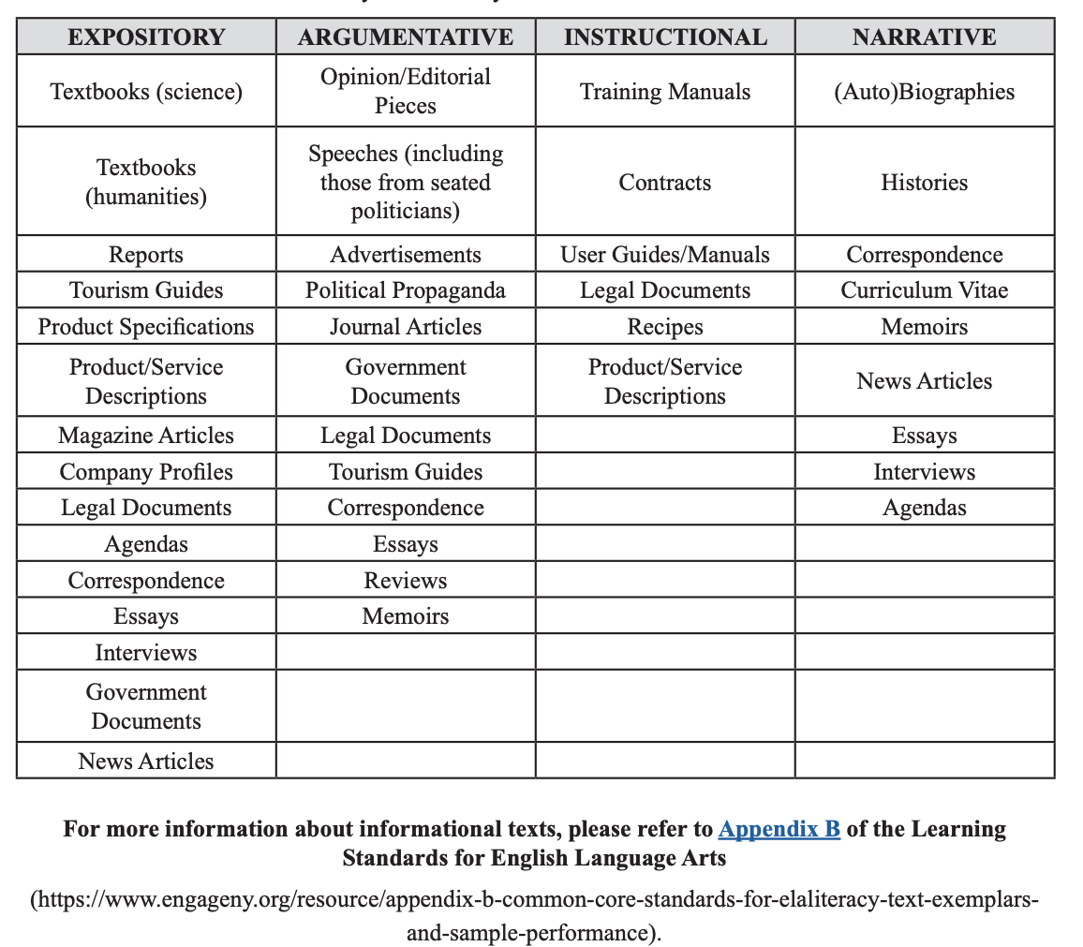
Types of Informational Texts:

Slide 10
3rd & 4th Grade Format
2020 Grades 3–4 English Language Arts Test Design
 | Session 1 | Session 2 | Total
 | Reading | Writing
Passages | 4 | 3 | 7
Multiple-Choice Questions | 24 | 0 | 24
Short-Response Questions | 0 | 6 | 6
Extended-Response Questions | 0 | 1 | 1
 | Total Number of Literary Passages |  | 3–4
 | Total Number of Informational Passages |  | 3–4

Slide 11
5th Grade Format
2020 Grades 5–6 English Language Arts Test Design
 | Session 1 | Session 2 | Total
 | Reading | Writing
Passages | 5 | 3 | 8
Multiple-Choice Questions | 35 | 0 | 35
Short-Response Questions | 0 | 6 | 6
Extended-Response Questions | 0 | 1 | 1
 | Total Number of Literary Passages |  | 3–5
 | Total Number of Informational Passages |  | 3–5

Slide 12
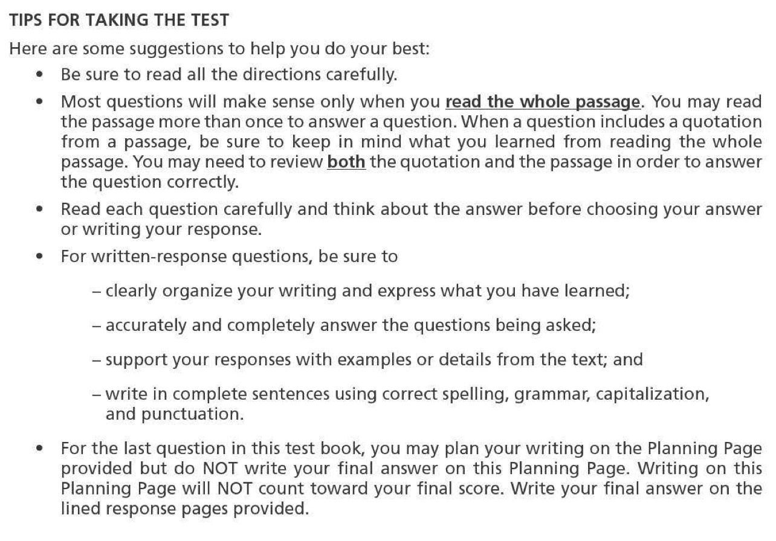
Advice for Students - ELA

Slide 13
Sample Multiple Choice Question
In paragraph 9, what is the most likely reason Riley stays quiet as she and Craig walk home?
A She is thinking about how well she played hockey.
B She is upset with Craig because he hurt her back.
C She is thinking about how to get skates for Craig.
D She is tired from skating in the hockey game.
2019-released-items-ela-g3.pdf

Slide 14
Sample Short Answer Question
2019-released-items-ela-g4.pdf

Slide 15
Sample Extended Response Question
2019-released-items-ela-g5.pdf

Slide 16
NYS Math Tests
Tests are untimed
Students will be provided with as much time as necessary to complete each test session within regular school hours
Students may work for as long as they need, as long as they are working productively
Students in grade 3 will likely need approximately 55-65 minutes of working time to complete Session 1 and 60–70 minutes of working time to complete Session 2
Students in grade 4 will likely need approximately 65-75 minutes of working time to complete Session 1 and 65–75 minutes of working time to complete Session 2
Students in grade 5 will likely need approximately 80–90 minutes of working time to complete Session 1 and 70–80 minutes of working time to complete Session 2
If students are still working, but most of their class has completed the test, they may be relocated to another room to finish

Slide 17
Types of Questions - Math
Some test questions target more than one standard or assess an entire cluster. As such, many individual test questions assess September-to-April standards in conjunction with May–June standards from past grades.
Multiple-Choice (1-point)
Students select the correct response from four answer choices. Many multiple-choice questions require students to complete multiple steps. Likewise, some of these questions are linked to more than one standard, drawing on the simultaneous application of multiple skills and concepts. Within answer choices, distractors2 will all be based on plausible missteps.

Slide 18
Types of Questions - Math cont.
If students are directed to show work or provide an explanation, a correct answer with no work shown or no explanation provided receives no credit.
Short-response (2-points)
Short-response questions require students to complete a task and show their work. Like multiple-choice questions, short-response questions will often require multiple steps, the application of multiple mathematics skills, and real-world applications.
Extended-response (3-points)
Extended-response questions ask students to show their work in completing two or more tasks or a more extensive problem. Extended-response questions allow students to show their understanding of mathematical procedures, conceptual understanding, and application. Extended-response questions may also assess student reasoning and the ability to critique the arguments of others.

Slide 19
Mathematics Test Format
2020 Grade 3 Test Design
Session | Number of Multiple- Choice Questions | Number of Short- Response Questions | Number of Extended-Response Questions | Total Number of Questions
1 | 25 | 0 | 0 | 25
2 | 8 | 6 | 1 | 15
Total | 33 | 6 | 1 | 40
2020 Grades 4 and 5 Test Design
Session | Number of Multiple- Choice Questions | Number of Short- Response Questions | Number of Extended-Response Questions | Total Number of Questions
1 | 30 | 0 | 0 | 30
2 | 8 | 6 | 1 | 15
Total | 38 | 6 | 1 | 45

Slide 20
Advice for Students - Mathematics

Slide 21
Mathematical Tools
No Calculators. Students are provided with the following materials for the test:
3rd Grade - Ruler
4th Grade - Ruler & Protractor
5th Grade - Ruler, Protractor & Reference Sheet

Slide 22
Sample Math Question
Multiple choice
Sample from 3rd grade NYS released questions - 2019

Slide 23
Sample Math Question
Short Answer
Sample from 4th grade NYS released questions - 2019

Slide 24
Sample Math Question
Extended Response
Sample from 5th grade NYS released questions - 2019

Slide 25
Ways to Help Your Child at Home
Provide a quiet space for homework. Make sure supplies are available – paper, scissors, glue, crayons, pens, pencils, etc.
Set up routines and reinforce good habits – homework time, reading time, etc.
Oversee technology - limit social media, gaming, and Youtube.
Encourage your child to read to you - have books and magazines around the house.
Visit your local library - borrow books and magazines in different genres.
Be a good listener – ask your child about the activities they are doing at school.
Reinforce the skills and concepts your child is learning at school, e.g. math skills through cooking and shopping, writing notes, etc.
Give your child as many different experiences as possible – take trips to museums, the zoo, shows, etc.

Slide 26
Test Taking Tips
Do not put undue pressure on your child
Make sure they get a good night’s sleep
Make sure they eat breakfast the day of the test
Do not send your child to take the test if they are not feeling well (there are makeup days)
Your child should bring three sharpened #2 pencils with erasers, but no “lucky pencils” or “special erasers” as they can be a distraction
Let them know that once the test is over, it is a normal day and the test is just a small part of that day

Slide 27
Links
https://www.engageny.org/resource/released-2019-3-8-ela-and-mathematics-state-test-questions
http://www.p12.nysed.gov/assessment/ei/2019/2019-faq-for-parents-3-8-tests.pdf
http://mc-14193-39844713.us-east-1.elb.amazonaws.com/parent-and-family-resources
https://www.engageny.org/videos-for-parents
http://ps174.org

Slide 28
PS 174 Philosophy on Testing:
It’s just another day to show what you know!

